Slide 1

Personalized Fitness Tracking System Using Django
Kunal Singh Tanwar, Niranjan, Akash Kumar, Vikrant Sehrawat
Under Supervison of Ms. Solanki Gupta
School of Engineering and Technology

Slide 2
Introduction
A fitness tracker is a digital tool designed to monitor workouts, nutrition, and overall health progress. It helps users track their daily activities, set goals, and analyze their fitness journey efficiently.
Importance
A structured tracking system provides valuable insights and encourages discipline.
Many individuals struggle with maintaining a consistent fitness routine.
Technology-driven fitness solutions enhance motivation and performance.

Slide 3
Objectives
User-Friendly Health Management
Effortless Workout & Meal Logging
Goal-Oriented Progress Tracking

Slide 4
Problem Statement
Lack of Structure creates inconsistent workout program
Data Silos means can work in all platforms like android and IOS.
Motivation for long term goal and step achievements

Slide 5
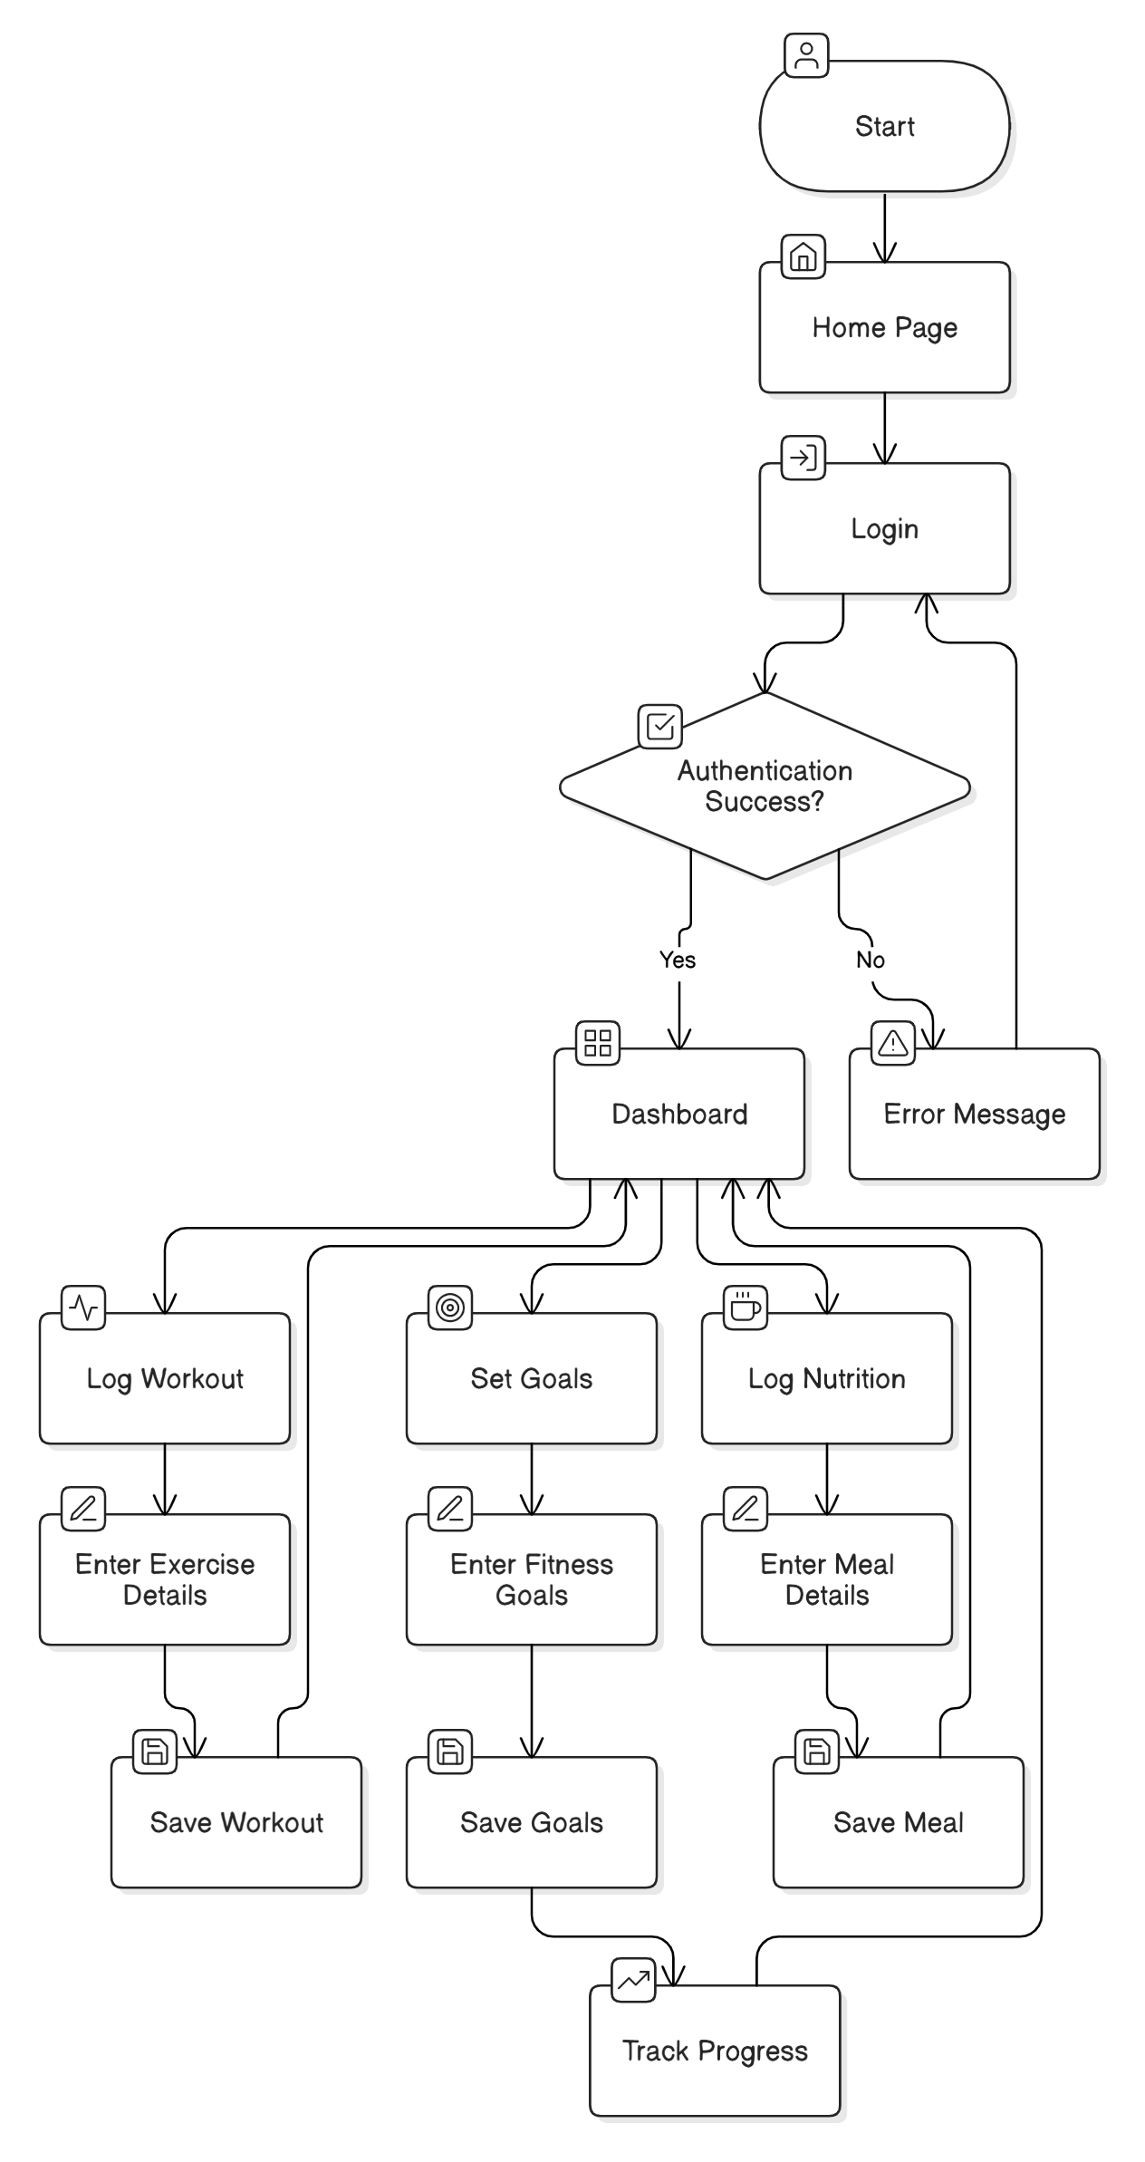
Methodology
3
our Name
Su

Slide 6
Expected Outcomes
Log workouts, track meals, and set goals with ease.
Get insights on calories, workout intensity, and progress tracking.
Stay motivated with a structured and engaging fitness tracking system.
our Name 4 (Under Supervison of

Slide 7
Track workouts, diet, and progress for a healthier lifestyle.
Applications
Help trainers monitor clients’ data for personalized fitness recommendations.
Assist patients in tracking recovery and physical activity progress.

Slide 8
Challenges and Limitations
Manual Data Entry :
Users must input workout and meal details, which may lead to errors.
No Wearable Integration :
Does not sync with fitness bands or smartwatches for automatic tracking.
Web-Only Access :
Lacks a mobile app for on-the-go tracking.

Slide 9
Conclusion
Enhances Fitness Tracking: Provides a structured system for monitoring workouts and nutrition.
Improves Goal Achievement: Helps users stay motivated and disciplined in their fitness journey.
Future Scope for Growth: Can be expanded with AI features, mobile support, and wearable integration.

Slide 10
Q&A
Questions?

